Slide 1
Introduction
Compiler Construction
Lecturer: Engr. Muhammad Ismail
CS Department Sukkur IBA University
Undergraduate (Fall - 2026)
Semester: V and VII

Slide 2
Computations
  how a program's instructions are
    analyzed, optimized, and transformed into
      machine-readable code
  Computation is any type of calculation or processing of information that follows a defined set of rules or an algorithm
    It turns inputs like numbers or data into specific
      outputs using math or logic.
  Core Elements
    Input and Output:
      Takes raw data and transforms it into a useful result.
    Rules and Programs:
      Follows precise, step-by-step instructions (algorithms) that direct how the process changes over time.
    State Changes:
      Updates internal variables and data as it steps through the task.

Slide 3
Brief History
  The term compiler was coined in the
    early 1950s by
      Grace Murray Hopper.
  Compilers evolved from early,
    manual assembly translation into modular infrastructure
      capable of aggressive optimization and
      dynamic code generation.
  1952: The First Concept (A-0 System)
    Grace Hopper developed the A-0 System for the UNIVAC I, widely considered the first compiler. It functioned primarily as a loader or routine collection manager, translating mathematical code into subroutines stored on tape.
      UNIVAC I
        Universal Automatic Computer I
          the first commercial general-purpose electronic digital computer made in the United States

Slide 4
1957: The First Complete Compiler (FORTRAN I)
  Led by John Backus at IBM,
    the FORTRAN I compiler proved that high-level code could rival hand-written machine code in speed. It introduced fundamental compiler concepts including basic blocks, control flow analysis, and early code optimization.
    FORTRAN I
      Formula Translator
        released by IBM in 1957 and led by John Backus
          the world's first widely used high-level programming language and the first to feature an optimizing compiler, proving that automated code could rival hand-coded assembly.
1960s: Formalization & Self-Hosting
  Formal language theory matured with Noam Chomsky's grammar hierarchy and the development of Backus-Naur Form (BNF) used for ALGOL 60. This era saw the creation of recursive-descent parsing and the bootstrapping method, allowing compilers to be written in the very language they compile.
  When the source language is also the implementation language and the
    source text to be compiled is actually a new version of the compiler itself, the process is called bootstrapping.
  Noam Chomsky’s
    a renowned American linguist, philosopher, cognitive scientist, historical essayist, social critic, and political activist. He is widely considered the "father of modern linguistics."

Slide 5
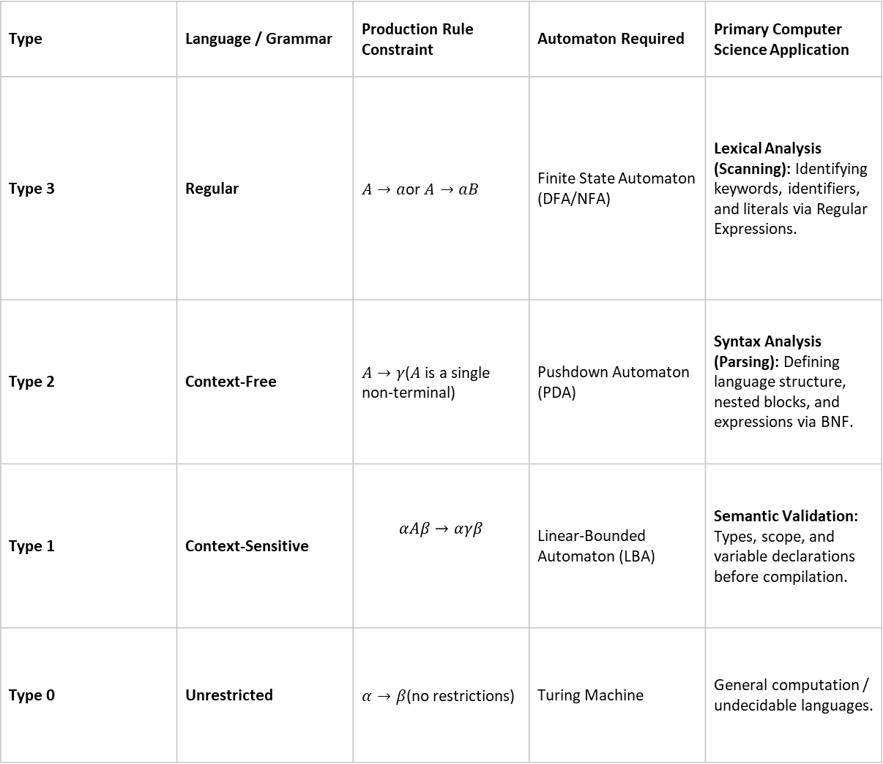
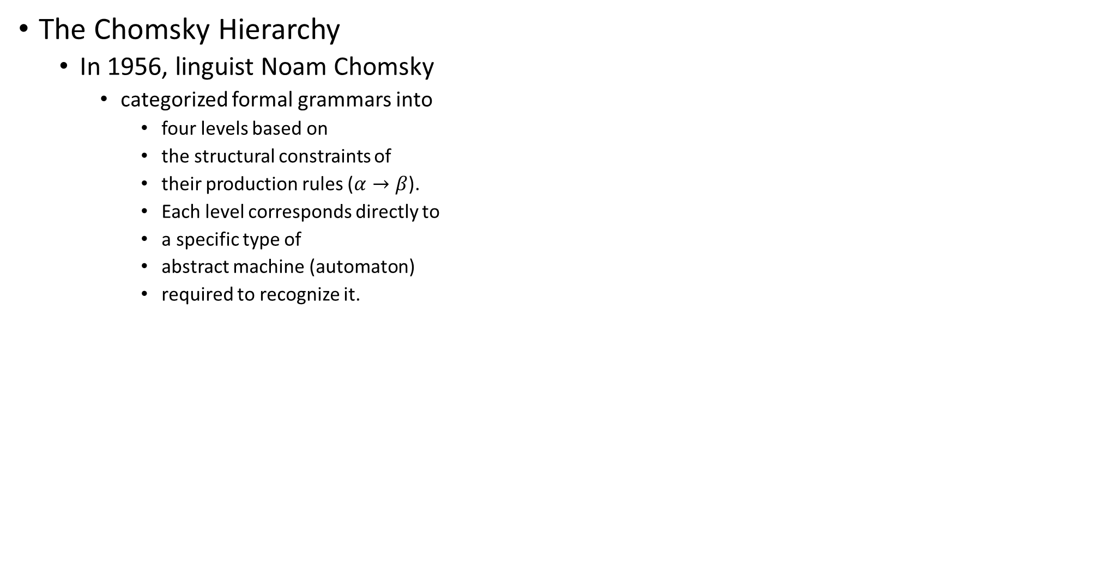
The Chomsky Hierarchy
  In 1956, linguist Noam Chomsky
    categorized formal grammars into
      four levels based on
      the structural constraints of
      their production rules ($α→β$).
      Each level corresponds directly to
      a specific type of
      abstract machine (automaton)
      required to recognize it.
Type | Language / Grammar | Production Rule Constraint | Automaton Required | Primary Computer Science Application
Type 3 | Regular | $A→a$or $A→aB$ | Finite State Automaton (DFA/NFA) | Lexical Analysis (Scanning): Identifying keywords, identifiers, and literals via Regular Expressions.
Type 2 | Context-Free | $A→γ$($A$ is a single non-terminal) | Pushdown Automaton (PDA) | Syntax Analysis (Parsing): Defining language structure, nested blocks, and expressions via BNF.
Type 1 | Context-Sensitive | $$αAβ→αγβ$$ | Linear-Bounded Automaton (LBA) | Semantic Validation: Types, scope, and variable declarations before compilation.
Type 0 | Unrestricted | $α→β$(no restrictions) | Turing Machine | General computation / undecidable languages.

Slide 6
Backus-Naur Form (BNF)
  While Chomsky developed his
    hierarchy for natural language analysis,
      computer scientists John Backus and Peter Naur independently needed a
      formal notation to specify the syntax of ALGOL 60.
      They developed BNF, which turned out to be a practical, human-readable metalanguage for defining Type 2 (Context-Free) Grammars.
  ALGOL 60
    ALGOL 60 (Algorithmic Language 1960)
      one of the most influential programming languages in computer science. Created by an international joint committee of American and European scientists, it established the design patterns, syntax conventions, and mathematical rigor that defined almost every imperative programming language that followed.
  Imperative programming
    a programming paradigm that uses statements to explicitly change a program's state. It focuses on how a computation should execute by providing a step-by-step sequence of commands for the computer to follow.
    Core Characteristics
      Explicit State Changes:
        Programs maintain state through variables, which are mutated over time using assignment statements.
      Sequential Execution:
        Instructions execute in a predictable top-to-bottom sequence unless interrupted by control structures.
      Control Flow Statements:
        Relies on explicitly managing execution order using loops (for, while), conditional branches (if-else), and jump statements (goto, break).
      Direct Memory Manipulation:
        Often allows direct reading and writing of specific memory locations or pointer addresses.

Slide 7
  Key Sub-paradigms
    Imperative programming serves as the foundation for several major operational styles:
      Procedural Programming:
        Groups imperative commands into reusable subroutines or functions (e.g., C, Pascal, Fortran).
      Object-Oriented Programming (OOP):
        Encapsulates imperative code and mutable state into objects containing methods and properties (e.g., Java, C++, Python).
Feature | Imperative Programming | Declarative Programming
Primary Focus | Describes how to achieve a result (step-by-step instructions). | Describes what result is desired (logic without execution steps).
State & Mutation | Heavily relies on mutable state and side effects. | Avoids mutable state; relies on immutable data and pure functions.
Control Flow | Explicitly defined via loops, conditionals, and function calls. | Implicitly handled by the underlying execution engine or solver.
Common Examples | C, C++, Java, Python, Go, Rust | SQL, HTML, Haskell, Prolog, XSLT

Slide 8
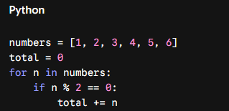

  Code Example (Imperative vs. Declarative)
    Imperative (Python): Manually loop through a list and mutate a accumulator variable to sum even numbers.
    Declarative / Functional Equivalent: State the filter and sum transformations without explicit loops or state mutation.

Slide 9
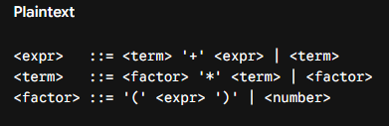
Meta-components of BNF:
  <Non-terminal>: Syntactic variables enclosed in angle brackets.
  ::=: Meaning "is defined as".
  |: Meaning "OR" (alternative production choices).
  Terminal: Actual symbols/tokens appearing in the code (e.g., if, +, number).
Example: Expression Syntax in BNF

Slide 10
  How They Came Together in Compiler Design
    The intersection of Chomsky's classification and Backus & Naur's notation transformed compiler construction from a manual, ad-hoc craft into an automated science:
      Phase Division: Frontends split naturally into two phases—Lexer (Type 3 / Regular) and Parser (Type 2 / Context-Free).
      Parser Generators: Tools like Yacc and Bison take a context-free grammar written in a BNF variant and automatically generate deterministic parsers (like LALR parsers).
      AST Construction: BNF rules form the foundation for building Abstract Syntax Trees (ASTs), which middle-ends optimize before code generation.
  Recursive-descent parsing and bootstrapping
    are two fundamental concepts in compiler implementation.
      Recursive descent provides a straightforward, hand-writable technique for syntactic analysis,
      while bootstrapping provides a practical method for building self-hosting language compilers from scratch.
1970s: UNIX, C, and Automated Frontend Generators
  Dennis Ritchie developed C,
    designed alongside UNIX to produce portable low-level systems software.
    Automated parser generator tools like Yacc (Yet Another Compiler-Compiler) and
    Lex simplified compiler design by generating lexers and parsers from context-free grammar specifications.

Slide 11
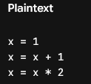
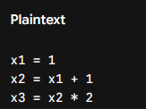
1980s–1990s: Modern Optimization & SSA Form
  Compilers shifted focus to sophisticated middle-end optimizations.
    Static Single Assignment (SSA) form was introduced,
      vastly simplifying optimization passes like
        global value numbering,
        dead code elimination,
        and register allocation via graph coloring.
    GNU's GCC became the open-source standard across platform architectures.
  Static Single Assignment (SSA)
    is an intermediate representation (IR) property used by
      modern compilers (such as LLVM, GCC, and the Go compiler) where
        every variable is assigned exactly once, and
          every variable must be defined before it is used.
      Non-SSA Code (Source Code):
SSA Form Transformation:

Slide 12
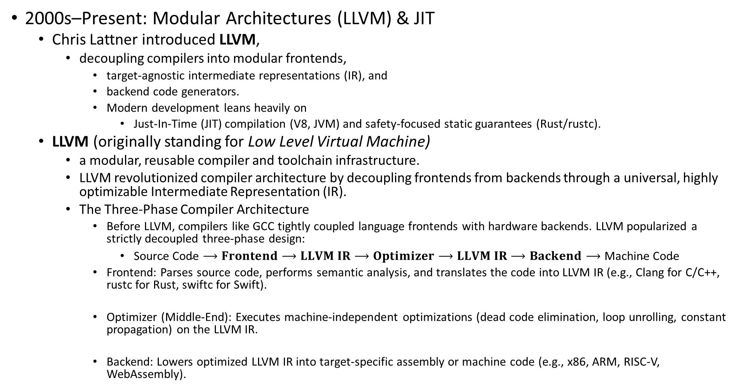
2000s–Present: Modular Architectures (LLVM) & JIT
  Chris Lattner introduced LLVM,
    decoupling compilers into modular frontends,
      target-agnostic intermediate representations (IR), and
      backend code generators.
      Modern development leans heavily on
        Just-In-Time (JIT) compilation (V8, JVM) and safety-focused static guarantees (Rust/rustc).
  LLVM (originally standing for Low Level Virtual Machine)
    a modular, reusable compiler and toolchain infrastructure.
    LLVM revolutionized compiler architecture by decoupling frontends from backends through a universal, highly optimizable Intermediate Representation (IR).
    The Three-Phase Compiler Architecture
      Before LLVM, compilers like GCC tightly coupled language frontends with hardware backends. LLVM popularized a strictly decoupled three-phase design:
        $\text{Source Code}⟶Frontend⟶LLVM IR⟶Optimizer⟶LLVM IR⟶Backend⟶\text{Machine Code}$
      Frontend: Parses source code, performs semantic analysis, and translates the code into LLVM IR (e.g., Clang for C/C++, rustc for Rust, swiftc for Swift).
      Optimizer (Middle-End): Executes machine-independent optimizations (dead code elimination, loop unrolling, constant propagation) on the LLVM IR.
      Backend: Lowers optimized LLVM IR into target-specific assembly or machine code (e.g., x86, ARM, RISC-V, WebAssembly).

Slide 13
LLVM Intermediate Representation (LLVM IR)
  LLVM IR is the universal language used across the entire toolchain. It is a strongly typed, RISC-like instruction set formatted in Static Single Assignment (SSA).
  Ahead-Of-Time (AOT) and Just-In-Time (JIT) compilation
Trade-off Factor | Ahead-Of-Time (AOT) | Just-In-Time (JIT)
Startup Overhead | Near Instant: Executes pre-compiled native binaries directly without runtime compilation delays. | Warm-up Latency: Higher initial overhead while interpreting bytecode or compiling hot code paths on the fly.
Peak Performance Potential | Static Optimization: Relies on compile-time static analysis, loop unrolling, and link-time optimizations (LTO). | Dynamic / Profile-Guided Optimization (PGO): Uses live execution profiles to dynamically inline, devirtualize, and optimize hot loops.
Memory Footprint | Minimal: Requires memory only for executable code and runtime application state. | Heavy: Requires additional RAM to keep the compiler engine, bytecode, virtual machine runtime, and profile counters active.
Portability & Distribution | Target-Specific Binaries: Must build separate platform-specific executables for every target OS/architecture. | Portable Bytecode: Distributes unified, platform-agnostic code (.class, .wasm) that runs anywhere a JIT engine exists.
Speculative Optimization | Conservative: Cannot make assumptions about dynamic call targets or runtime variable types. | Aggressive: Uses speculative optimization based on observed types, with ability to deoptimize (bail out) if assumptions fail.

Slide 14
Language processors
  software tools that
    translate, analyze, or execute programs
      written in
        high-level or low-level programming languages.
  Compilers form
    a primary category within this family,
      alongside interpreters, assemblers, and
        hybrid translation pipelines.
  Types of Language Processors
    Compiler:
      Translates entire high-level source code into low-level machine code or intermediate object code all at once before execution.
    Interpreter:
      Translates and executes high-level source code line-by-line or instruction-by-instruction directly at runtime without producing an intermediate standalone executable binary.
    Assembler:
      Converts low-level assembly language mnemonics (e.g., MOV, ADD) directly into target machine code instructions.

Slide 15
  Types of Language Processors
    Hybrid Translator (JIT / Bytecode):
      Compiles source code into portable intermediate bytecode (e.g., Java .class files), which is then interpreted or compiled to native machine code at runtime via a Just-In-Time (JIT) compiler.
    Pre-processor:
      Modifies high-level source code before compilation begins by executing directives like macro expansions, conditional inclusion, and file inclusions (e.g., #include or #define in C/C++).
      Macro expansion
        is the process where a language preprocessor or compiler replaces a macro name or invocation with its defined sequence of instructions before actual compilation or parsing begins.
How Macro Expansion Works
  Definition:
    A macro is declared with a identifier and a replacement text (and optional parameters).
  Textual Substitution:
    During the preprocessing stage, the preprocessor scans the source code. Whenever it encounters a macro identifier, it literally swaps that token with the macro's body text.
  No Type Checking:
    Because expansion happens purely as string/token manipulation before lexical analysis or type checking, the macro mechanism does not validate variable types or scope.

Slide 16
  Types of Macros
    Object-like Macros:
      Simple identifier substitutions used primarily for constants.
      // Preprocessor expands `int buffer[MAX_BUFFER_SIZE];` to `int buffer[1024];`
      #define MAX_BUFFER_SIZE 1024
    Function-like Macros:
      Take arguments and substitute them into the expanded expression text.
      // Preprocessor expands `int area = SQUARE(5);` to `int area = ((5) * (5));`
      #define SQUARE(x) ((x) * (x))
Decompiler / Transpiler:
  Translates code from one representation to another
    at a similar abstraction level, such as
      converting machine code back into C (Decompiler) or
      translating TypeScript into JavaScript (Transpiler / Source-to-Source Compiler).

Slide 17
Compiler vs. Interpreter
Feature | Compiler | Interpreter
Execution Model | Separate translation and execution phases. | Simultaneous translation and execution.
Output | Standalone target binary executable (.exe, .so, or machine binary). | No standalone binary generated; requires runtime engine.
Execution Speed | Faster runtime execution after initial build phase. | Slower execution due to continuous runtime translation.
Error Reporting | Detects all syntax/semantic errors during compile time before execution. | Halts execution immediately at the first encountered error at runtime.
Memory Usage | Lower runtime memory overhead (does not keep compiler in RAM). | Higher memory footprint (requires active interpreter engine in RAM).
Examples | C, C++, Rust, Go | Python, Ruby, PHP, Bash

Slide 18
Primary Functions of a Compiler in Language Processing
  Syntax & Semantic Validation:
    Verifies that source code strictly follows the formal rules (lexical, grammatical, and type constraints) of the target programming language.
  Intermediate Representation (IR):
    Lowers high-level abstractions into structured, target-agnostic internal representations (such as Abstract Syntax Trees and SSA form) for multi-pass analysis.
  Optimization:
    Restructures code logic to minimize execution time, lower memory consumption, and maximize target CPU instruction pipeline efficiency.
  Code Generation:
    Maps abstract language constructs to specific hardware instructions, register configurations, and system call interfaces.
  The language the compiler itself is written in is the
    implementation language

Slide 19
Abstract Syntax Tree (AST)
  a finite, labeled, deeply nested
    tree data structure that
      represents the structural syntax of source code in a programming language.
  It is "abstract" because
    it omits non-essential syntactic details
      present in the raw source code
        such as punctuation, semicolons, explicit grouping parentheses, and white space—focusing purely on the structural logic and operational semantics.
  Source Code vs. Parse Tree vs. AST
    When a compiler processes code, it moves from raw text to structural graphs:
      Concrete Syntax Tree (Parse Tree): Contains every literal token matched by the grammar, including syntactic noise like commas, matching braces, and operator tokens.
      Abstract Syntax Tree (AST): Discards structural fluff and represents only the core operations, operands, statements, and control-flow expressions as parent-child nodes.

Slide 20

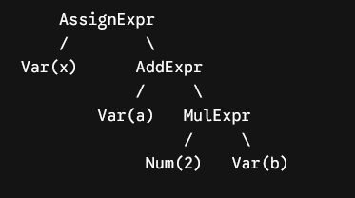
Example Code:
Corresponding AST Representation:

Slide 21
Role of the AST in Compiler Pipelines
  The AST acts as the central bridge between a language compiler's frontend (parsing) and middle/backend components:
    Semantic Analysis:
      Type checkers traverse the AST nodes to ensure type compatibility, verify variable declarations within current lexical scope, and enforce language constraints.
    Intermediate Representation (IR) Lowering:
      The compiler converts the fully validated AST into
        three-address code, control flow graphs (CFGs), or SSA forms (like LLVM IR) for optimization passes.
    Transpilation & Formatting:
      Code formatters (e.g., Prettier), linters (e.g., ESLint), and source-to-source transpilers
        modify or analyze the AST before generating modified target code.
    Refactoring Tools & IDEs:
      Features like
        symbol renaming, method extraction, and auto-completion rely on
          holding and manipulating an in-memory AST of the active codebase.

Slide 22
AST Node Structure
  Every node in an AST represents a programming construct.
  Common node categories include:
    Statements:
      IfStatement, ForLoop, ReturnStatement, VariableDeclaration
    Expressions:
      BinaryExpression, UnaryExpression, FunctionCall, AssignmentExpression
    Literals & Identifiers:
      NumericLiteral, StringLiteral, Identifier

Slide 23
The Structure of a Compiler
  A modern compiler is structured as
    a pipeline of distinct phases,
    broadly categorized into three main sections:
      the Frontend (language-dependent),
      the Middle-End (target-independent optimization), and
      the Backend (hardware-dependent).
      The part of a compiler that performs the analysis of the source language text
        is called the front-end, and the part that does the target language synthesis is the
        back-end;
  The Frontend (Analysis Phase)
    The frontend reads
      the raw source code,
        verifies its grammatical and semantic correctness, and
          converts it into an internal representation.
    Lexical Analysis (Scanner):
      Converts the raw character stream into a sequence of meaningful tokens (keywords, identifiers, operators, literals). It strips out whitespace and comments using regular expressions and finite automata.
    Syntax Analysis (Parser):
      Group tokens into a hierarchical structure called an Abstract Syntax Tree (AST) according to the rules of a Context-Free Grammar (often specified in BNF). It ensures the program obeys language syntax rules.
    Semantic Analysis:
      Checks the AST for logical consistency and semantic rules that context-free grammars cannot enforce. Key tasks include type checking, scope verification, and checking that functions are called with valid arguments.

Slide 24
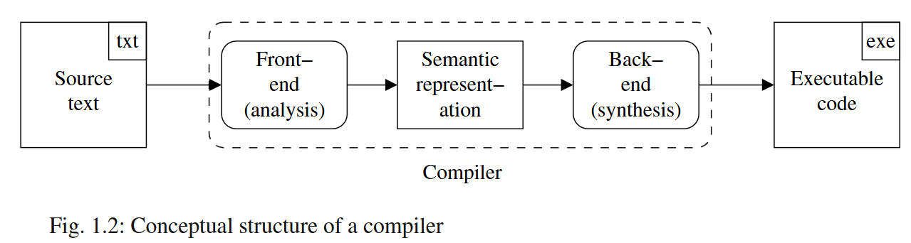

Slide 25
The Middle-End (Synthesis & Optimization Phase)
  The middle-end decouples the input language from the hardware architecture, allowing optimizations to run independently of the target platform.
  Intermediate Code Generation:
    Converts the validated AST into a target-agnostic Intermediate Representation (IR),
      such as three-address code or
      Static Single Assignment (SSA) form (e.g., LLVM IR).
  Machine-Independent Optimization:
    Analyzes and transforms the IR to make the program run faster or
      use less memory.
    Operations include:
      Dead Code Elimination:
        Removing unused variable definitions or unreachable execution paths.
      Constant Folding & Propagation:
        Computing constant expressions at compile time.
      Loop Invariant Code Motion:
        Hoisting calculations outside of loops if their values do not change per iteration.

Slide 26
The Backend (Generation Phase)
  The backend translates the optimized IR into physical machine instructions optimized for a specific CPU architecture (x86, ARM, RISC-V).
    Instruction Selection:
      Maps abstract IR operations to actual CPU machine instructions.
    Register Allocation:
      Maps an arbitrary number of IR variables to a finite set of physical CPU registers using algorithms like graph coloring.
        Spill code is inserted to store excess variables in RAM when registers run out.
    Instruction Scheduling:
      Reorders assembly instructions to avoid hardware pipeline stalls and maximize CPU instruction throughput.
    Code Emission:
      Outputs target binary code, relocatable object files, or assembly code.
Symbol Table & Error Handler
  Two global support components interact across almost all phases:
    Symbol Table:
      A specialized data structure (hash table/tree) that stores information about identifier names, types, scope levels, memory offsets, and function signatures encountered throughout compilation.
    Error Handler:
      Captures, reports, and gracefully recovers from errors encountered during scanning, parsing, semantic analysis, or code generation.

Slide 27
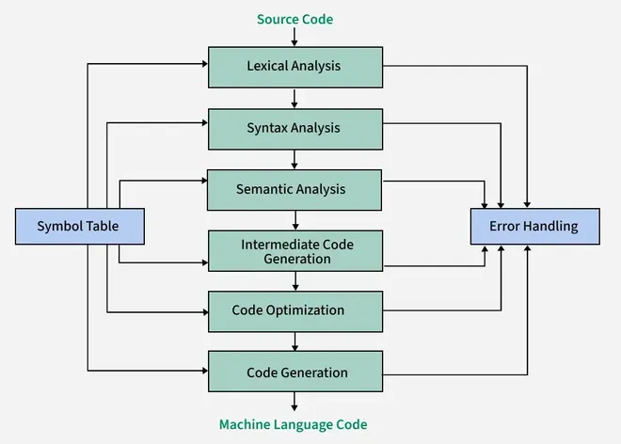
The Structure of a Compiler (RF1)

Slide 28
Types of Compilers
  Compilers can be categorized based on
    their architecture, execution model, build target, and execution timing.
      By Target & Output Format
        Native Compiler:
          Compiles source code into machine code designed specifically for the same operating system and CPU architecture that the compiler itself runs on (e.g., compiling C code on x86-64 Linux to run on x86-64 Linux).
        Cross Compiler:
          Runs on one architecture/system (the host) but generates executable binary code for a completely different target architecture (e.g., compiling code on an x86-64 workstation to run on an embedded ARM or RISC-V microcontroller).
        Source-to-Source Compiler (Transpiler):
          Translates source code written in one high-level language into another high-level language at a similar level of abstraction (e.g., TypeScript to JavaScript, or Babel transpiling modern ES6+ JS to ES5).
        Decompiler:
          Reconstructs high-level source code from low-level machine code binaries or bytecodes (e.g., Ghidra or CFR turning Java .class files back into Java code).

Slide 29
Types of Compilers
  By Execution Timing & Strategy
    Ahead-Of-Time (AOT) Compiler:
      Translates entire source files into machine code executables before program execution begins (e.g., gcc, rustc, go).
    Just-In-Time (JIT) Compiler:
      Compiles intermediate bytecode into native machine code on the fly at runtime during execution, leveraging live profiling metrics to optimize hot execution paths (e.g., Java HotSpot VM, V8 JavaScript engine).
    Ahead-of-Time / JIT Hybrid Compiler:
      Combines pre-compilation with runtime compilation to balance startup speed and peak throughput (e.g., Android's ART, which pre-compiles apps during installation via AOT while applying JIT optimization passes during runtime).
  By Structural Pass Architecture
    Single-Pass Compiler:
      Scans and translates source code sequentially from top to bottom in a single pass, outputting machine code immediately. Requires fast compilation times but limits global code optimizations (e.g., early Pascal compilers).
    Multi-Pass Compiler:
      Processes code across multiple distinct phases—converting source code to AST, then to Intermediate Representation (IR/SSA), performing optimization passes, and generating machine code. Allows aggressive global optimizations at the cost of compilation speed (e.g., Clang/LLVM, GCC).

Slide 30
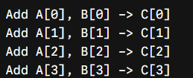
Specialized Compiler Types
  Parallelizing / Vectorizing Compiler:
    Analyzes sequential code structures (like loops) and automatically converts them to exploit parallel hardware features like SIMD instructions or multi-core threads.
      SIMD (Single Instruction, Multiple Data)
        is a parallel computing execution model where a single CPU instruction operates simultaneously on multiple data elements packed into wide vector registers.
        It forms the foundation of modern data-level parallelism in microprocessors.
      In traditional SISD (Single Instruction, Single Data) processing,
        performing an operation on four numbers requires four separate instructions executed sequentially.
        Under SIMD, vector registers store multiple scalar values side-by-side, allowing one instruction to process them in parallel in a single CPU cycle.
      SISD (Scalar Addition):
      SIMD (Vector Addition):

Slide 31
Specialized Compiler Types
  Parallelizing / Vectorizing Compiler:
    Common Applications
      Digital Signal Processing (DSP) & Audio:
        Filtering, FFT calculations, and audio codec processing.
      Graphics & Game Engines:
        3D vector/matrix transformations, vertex processing, and ray tracing primitives.
      Image & Video Processing:
        Pixel manipulation, convolution masks, and video encoding (H.264, HEVC, AV1).
      Machine Learning & Cryptography:
        Matrix multiplication kernels (GEMM), tensor contractions, and vectorized hash evaluations.
  Incremental Compiler:
    Re-compiles only the specific functions, blocks, or modules that changed since the last build rather than recompiling the entire project, drastically speeding up development feedback loops (e.g., IDE language servers).

Slide 32
Compiler
  a program or group of programs that translates one language into another
    the source code of a high-level computer language is translated into assembly language.
  Compilers are complex programs.
    they're often broken into
      several distinct chunks, called passes,
      that communicate with one another via temporary files.
  The passes themselves are only part of the compilation process
  The assembler, linker, and so forth are not considered to be part of the compiler.
    The structure of a typical four-pass compiler is shown in Figure 1.1
  The preprocessor is the first pass.
  Preprocessors
    typically do macro substitutions, strip comments from
      the source code, and handle various housekeeping tasks with which you don't want to
        burden the compiler proper
  The second pass is the heart of the compiler.
    It is made up of a lexical analyzer, parser, and code generator, and it translates the source code into an
      intermediate language that is much like assembly language.
  The third pass is the optimizer,
    which improves the quality of the generated intermediate code, and
  the fourth pass,
    the back end,
      translates the optimized code to real assembly language or some form of binary, executable code.

Slide 33
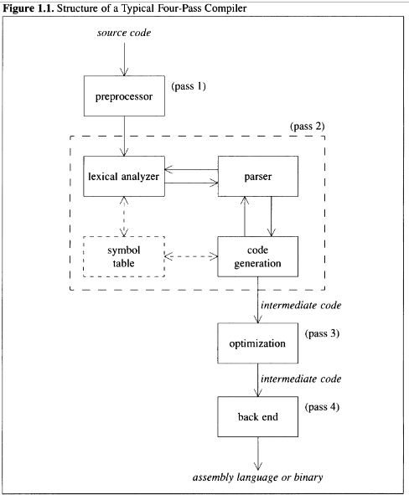

Slide 34
The Lexical Analyzer
  Often called a scanner or tokenizer
    translates the input into a form that's more useable by the
      rest of the compiler.
      a token is an indivisible lexical unit
        In
        C, keywords like while or for are tokens (you can't say wh ile),
        symbols like >,>=,
        >>,and>>= are tokens, names and numbers are tokens, and so forth.
      The original string that comprises the token is called a lexeme.
      A lexical analyzer translates lexemes into tokens.
      Scanner is self-contained unit.
        interfaces with the rest of the compiler via a small number (typically one or two) of subroutines and global variables.
        The parser calls the lexical-analyzer every time it needs a new token, and the analyzer returns that token and the associated lexeme.
  Token, Patterns, and Lexemes
    A token is a category, like a keyword or identifier
      a token is the smallest unit of meaningful data; it may be an operator, or symbol.
    A pattern defines the structure that matches a token, such as a regular expression for an identifier.
    A lexeme is the actual sequence of characters in the source code that matches a token’s pattern.

Slide 35
Token, Patterns, and Lexemes
  During scanning the source code,
    white space characters, comments, carriage return characters, preprocessor directives, macros, line feed characters, blank spaces, tabs, etc.
      are removed.
    if the source code contains invalid constants, incorrect spelling of keywords, etc. is taken care of by the lexical analysis phase. Regular expressions are used as a standard notation for specifying tokens of a programming language.
  A token represents
    a series or sequence of characters that cannot be decomposed further.
    In languages such as C, some examples of tokens would include:
      Keywords : Those reserved words in C like ` int `, ` char `, ` float `, ` const `, ` goto `, etc.
      Identifiers: Names of variables and user-defined functions.
      Operators : ` + `, ` - `, ` * `, ` / `, etc.
      Delimiters /Punctuators: Symbols used such as commas " , " semicolons " ; " braces ` {} `.
      By and large, tokens may be divided into three categories:
      Terminal Symbols (TRM) : Keywords and operators.
      Literals (LIT) : Values like numbers and strings.
      Identifiers (IDN) : Names defined by the user.

Slide 36
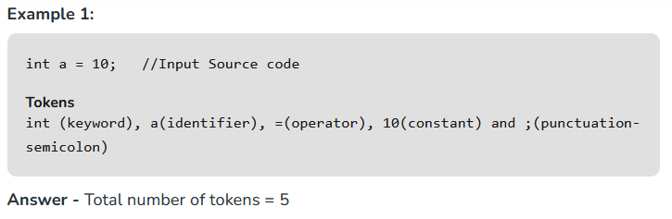
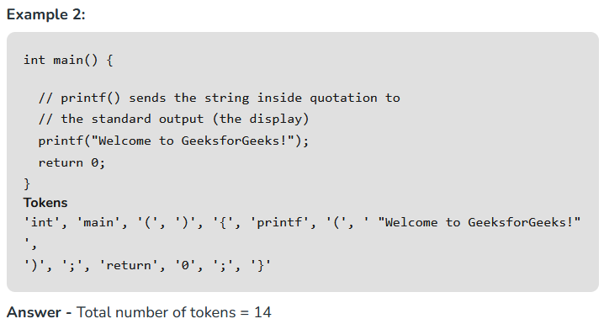
Examples:

Slide 37
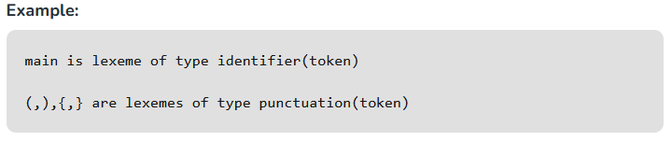
A lexeme
  is a sequence of source code that
    matches one of the predefined patterns and thereby forms a valid token. For example, in the expression `x + 5`, both `x` and `5` are lexemes that correspond to certain tokens.
A pattern
  is a rule or syntax that designates how tokens are identified in a programming language.
The output of Lexical Analyzer
  serves as an input to Syntax Analyzer
    as a sequence of tokens
The Lexical Analyzer
  not only provides a series of tokens but
    also creates a Symbol Table that consists of all the tokens present in the source code except Whitespaces and comments.

Slide 38
Note
  that there is not a one-to-one relationship between lexemes and tokens. A name or number token, for example, can have
    many possible lexemes associated with it; a while token always matches a single lexeme.

Slide 39
The Parser
  To parse an English sentence is to break it up into its component parts in order to
    analyze it grammatically. For example, a sentence like this:
      Jane sees Spot run.
        is broken up into a subject ("Jane") and a predicate ("sees Spot run").
        The predicate is
          in tum broken up into a verb ("sees"), a direct object ("Spot"), and a participle that
            modifies the direct object ("run").
    A compiler performs this same process (of decomposing a sentence into its component parts) in the parser phase
    A syntax tree is a hierarchical tree structure that represents the syntactic structure of a string or program according to a specific formal grammar. Depending on the context—computer science or linguistics—it breaks down source code or human language into structured components.
      1. Abstract Syntax Tree (AST) Used by compilers and interpreters to represent computer code. It strips away extra punctuation, parentheses, and syntactic clutter (like semi-colons), keeping only the core logical operations.
      2. Concrete Syntax Tree (Parse Tree) Represents the exact grammatical structure of the input string as defined by a formal grammar. Unlike an AST, it includes every token—such as parentheses, punctuation, and non-terminal symbols.

Slide 40
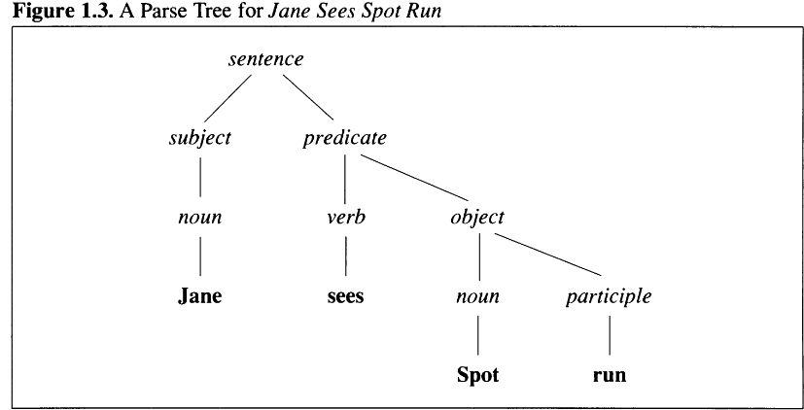

Slide 41
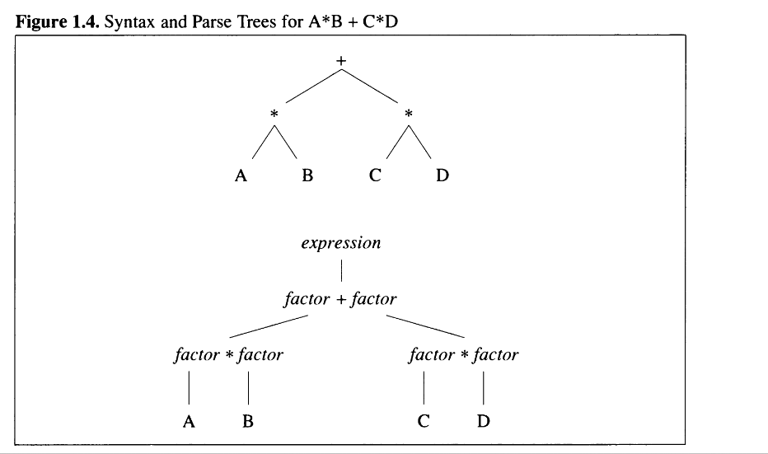

Slide 42
A sentence
  is also a technical term, though it means the same thing as it
    does in English.
    It's a collection of tokens that follow a well-defined grammatical structure.
    In the case of a compiler, the sentence is typically an entire computer program.
A parser
  is a group of subroutines that
    converts a token stream into a
      parse tree, and a parse tree is a structural representation of the sentence being parsed.
  the parse tree represents
    the sentence in a hierarchical fashion,
    moving from a general description of the sentence (at the root of the tree) down to the
    specific sentence being parsed (the actual tokens) at the leaves.
  some keep track of where they are in the tree,
    without creating a physical tree

Slide 43
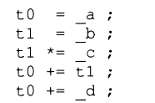
The Code Generator
  Though compilers can generate object code directly, they often defer code generation to a second program.
  Instead of generating machine language directly, they create a program in an intermediate language that is translated by the compiler's back end into actual machine language.
  an intermediate language
    is a sort-of super
      assembly language that's designed for performing specific tasks (such as optimization).
  A final use of an intermediate language is found in incremental compilers or interpreters.
    These programs shorten the development cycle by executing intermediate code
      directly, rather than translating it to binary first, thereby saving the time necessary for
        assembling and linking a real program.
    For example, an expression like x=a+b*c+d is
      translated into something like this:
      The t 0 and t 1 in the foregoing code are
        temporary variables that the compiler allocates
        to hold the result of the partially-evaluated expression.
          These are called anonymous temporaries (often shortened to just temporaries)

Slide 44
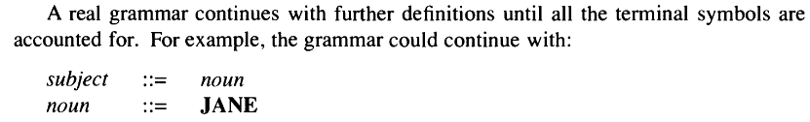
Grammars and Parse Trees
  The most common method used to describe a programming language in a formal way
    is also borrowed from linguistics. This method is a formal grammar, originally
    developed by M.I.T.'s Noam Chomsky and applied to computer programs by J.W.
    Backus for the first FORTRAN compilers.
  Formal grammars
    Backus-Naur Form (also called Backus-Normal Form)
    A strict BNF representation starts with a set of tokens, called terminal symbols, and a set of definitions, called nonterminal symbols.
    The definitions create a system in which every legal structure in the language can be represented.
      One operator is supported, the ::= operator, translated by the phrase "is defined as" or "goes to."
      For example, the following BNF rule might start a grammar for an English sentence:
        sentence ::= subject predicate
          A sentence is defined as a subject followed by a predicate.
          “a sentence goes to a subject followed by a predicate."
          Each rule of this type is called a production.

Slide 45
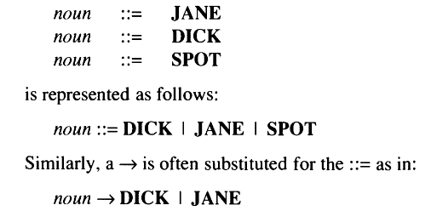
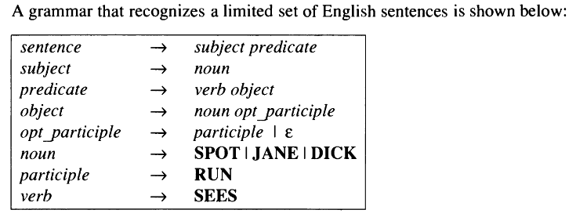
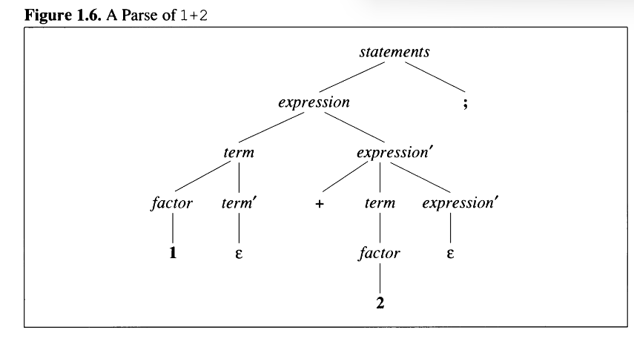

Slide 46
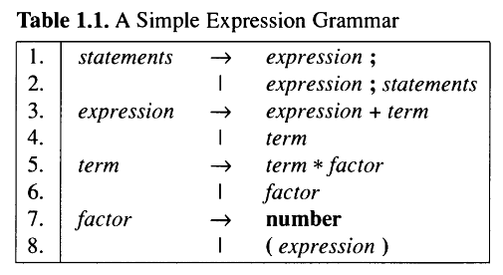
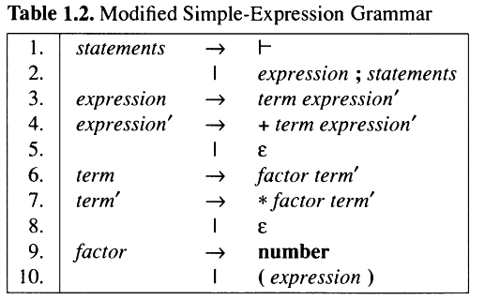

Slide 47
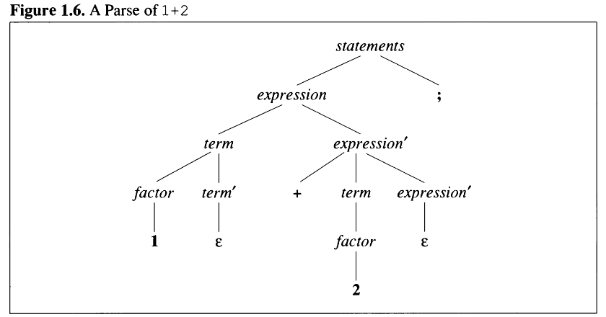

Slide 48
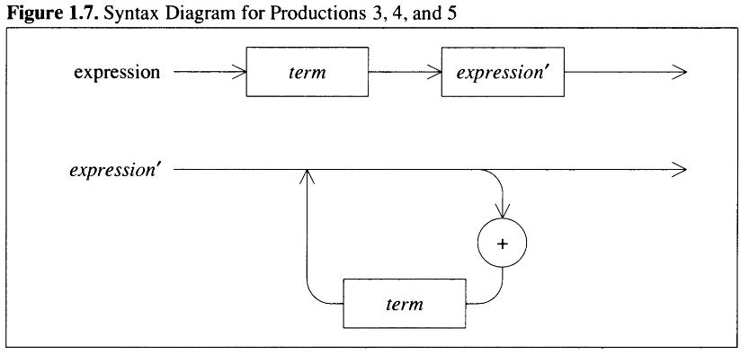

Slide 49
GCC install
  Step 1: Install MinGW (GCC) via Command Prompt
    winget install MSYS2.MSYS2
  Step 2: Install GCC using MSYS2
    Open the MSYS2 UCRT64 terminal from your Windows Start Menu.
    Run this command inside the MSYS2 window:
      pacman -S --noconfirm mingw-w64-ucrt-x86_64-gcc
  Step 3: Add GCC to Windows PATH
    C:\msys64\ucrt64\bin
  gcc --version
  gcc ARecursiveDescentExpressionCompiler.c -o compiler.exe

Slide 50
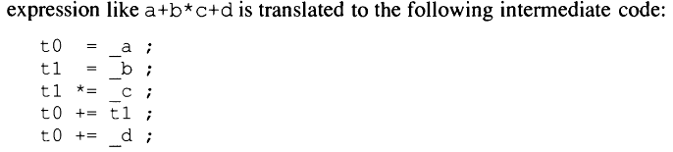
A Recursive-Descent Expression Compiler
  The Lexical Analyzer
    A NUM_OR_ID
      token is used both for numbers and identifiers; so, they are made up of a series of contiguous characters in the range ' 0' -' 9' , ' a'-' z' , or 'A'-' z' .
    The tokens themselves are defined with the macros at the top of lex.h
      The lexical analyzer
        translates a semicolon into a SEMI token, a series of digits into a NUM_OR_ID token

Slide 51
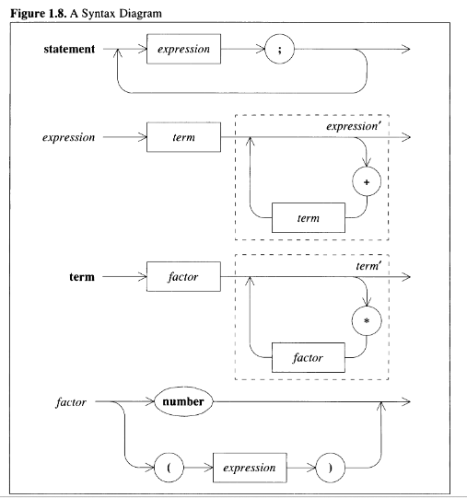

Slide 52
A Recursive-Descent Expression Compiler
  The Lexical Analyzer

Slide 54
References
  (RF1): https://media.geeksforgeeks.org/wp-content/uploads/20250125122657693266/compiler-660.webp

